Slide 1

CMR Technical Campus Department of CSE
Industrial Oriented Mini Project
Project Title: REAL TIME CREDIT CARD FRAUD DETECTION USING ML
Project Supervisor:​
Name:​ Saba Sultana
Designation: Assistant Professor
Presented By:​
Batch No: 06
H. No: 227R1A05L5 Name: Ch. Swetha
H. No: 227R1A05P7 Name: M. Vasantha
H. No: 227R1A05R3 Name: V. Mounika
​

Slide 2
Index
Design/Architecture
Modules
UML Diagrams
Sample code
Result​
Conclusion
Future Scope
References​
Github link
Department Vision and Mission
Abstract​
Introduction
Literature Review
problem definition
Objective
Existing system
Proposed system
Hardware and Software requirements
Novelty

Slide 3
Department Vision and Mission
DEPARTMENT VISION: To provide quality education and a conducive learning environment in computer engineering that foster critical thinking, creativity, and practical problem-solving skills.
DEPARTMENT MISSION:
1. To educate the students in fundamental principles of computing and induce the skills needed to solve practical problems.
2. To provide State-of-the-art computing laboratory facilities to promote industry institute interaction to enhance student’s practical knowledge.
3. To inculcate self-learning abilities, team spirit, and professional ethics among the students to serve society.

Slide 4
Abstract
With the surge in digital transactions, credit card fraud has become a major concern for banks and financial institutions. This project employs the Random Forest algorithm to enhance fraud detection accuracy by analyzing transaction patterns. The model classifies transactions as legitimate or fraudulent based on key attributes, optimizing results through accuracy, sensitivity, specificity, and precision. A graphical model provides insights into fraudulent trends, helping financial institutions take proactive measures. By leveraging machine learning, this approach minimizes false positives and improves real-time fraud detection, ensuring secure transactions.​A graphical model visualizes fraudulent patterns, enhancing detection efficiency. Helping banks take proactive measures. By leveraging machine learning, this approach enhances real-time fraud detection, minimizes false positives, and ensures secure transactions.

Slide 5
Introduction
With the rise of digital transactions, credit card fraud detection has become a major challenge. Researchers have explored various techniques, including Artificial Intelligence, Data Mining, Fuzzy Logic, and Machine Learning, to develop efficient fraud detection models. This project focuses on Machine Learning-based fraud detection, leveraging the Random Forest algorithm to classify transactions as genuine or fraudulent. Machine learning enables self-learning models that detect fraud based on multiple features, such as account age, transaction value, and origin. Unlike traditional methods, ML algorithms adapt dynamically, improving detection accuracy over time. This approach enhances fraud detection by automating analysis, reducing manual intervention, and improving real-time detection, making financial transactions more secure.
​

Slide 6
Literature Review
Approach | Key Characteristics | Strengths | Limitations
Traditional Methods | Rule-based systems and statistical models | - Simple to implement- Transparent decision-making | - Lack adaptability to evolving fraud patterns- Limited accuracy with complex data
Machine Learning | Decision Trees, Support Vector Machines (SVM), Neural Networks | - Ability to learn from data- Can handle complex patterns- Improved accuracy over traditional methods | - Prone to overfitting- High computational cost- Require large datasets
Random Forest (RF) | Ensemble of decision trees using bagging and feature randomness | - High accuracy and robustness- Handles imbalanced data effectively- Provides feature importance analysis | - Increased computational requirements with more trees- Reduced interpretability due to ensemble nature

Slide 7
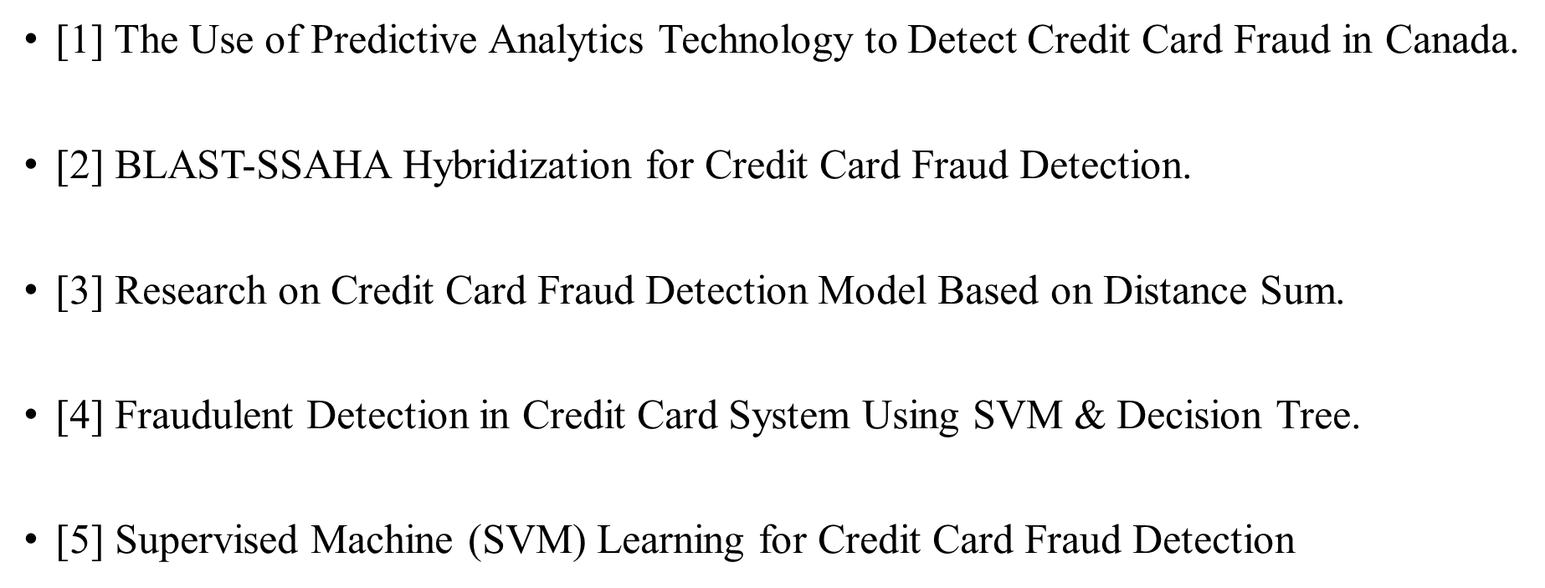

Slide 8
Problem Definition
​Credit card fraud is a growing global threat, causing billions in losses every year. As fraudsters evolve with advanced technology, traditional security measures struggle to keep up.
🔹 48% of businesses face financial crimes (PwC, 2017). 🔹 Fraud impacts banks, merchants, and individuals, leading to huge financial losses and broken trust. 🔹 Beyond money, businesses suffer reputation damage, pushing customers toward competitors.
With fraud becoming smarter and harder to detect, a powerful fraud detection system is no longer an option—it’s a necessity!

Slide 9
Objectives​
Enhance Fraud Detection Accuracy – Leverage Random Forest to improve precision in identifying fraudulent transactions.
🔹 Reduce Financial Losses – Detect fraud early to protect banks, businesses, and customers from major losses.
🔹 Handle Imbalanced Data – Ensure fraud detection even when fraudulent cases are rare in large datasets.
🔹 Enable Real-Time Detection – Develop a fast and scalable system to catch fraud as it happens.
🔹 Strengthen Security & Trust – Build a reliable fraud prevention system to boost confidence in digital transactions.

Slide 10
Existing System
Credit card fraud detection using Cluster Analysis and ANNs.
Data normalization improves model performance.
Clustering reduces neuronal inputs, optimizing ANN efficiency.
Based on unsupervised learning with real-life transactional data (confidential details protected).
50% accuracy achieved; Bayes minimum risk algorithm reduces cost by 23%.
Disadvantages
Collative comparison measure for fraud detection effectiveness is uncertain.
Cost-sensitive method using Bayes minimum risk may not generalize well.

Slide 11
Proposed System
Random Forest algorithm is used for credit card fraud detection.
It consists of multiple decision trees, reducing overfitting.
Fast training even on large datasets, as trees train independently.
Provides accurate classification and is resistant to overfitting.
Advantages
Ranks feature importance in classification.
Uses transaction amount to aid fraud detection.
Binary classification: Fraud (1) or Non-fraud (0).

Slide 12
Requirement Analysis​
HARDWARE REQUIREMENTS:
System : Pentium IV 2.4 GHz.
Hard Disk : 40 GB.
Floppy Drive : 1.44 Mb.
Monitor : 14’ Colour Monitor.
Mouse : Optical Mouse.
Ram : 512 Mb.

Slide 13
SOFTWARE REQUIREMENTS:
Operating system : Windows 7 Ultimate.
Coding Language : Python.
Front-End : Python.
Designing : Html, css, javascript.
Data Base : MySQL.

Slide 14
Novelty:-
Real-Time Detection: Fraud is identified instantly as transactions occur, unlike traditional batch methods.
Optimized Random Forest: Enhanced for low-latency predictions with tuned hyperparameters and reduced complexity.
Imbalanced Data Handling: Uses advanced sampling techniques to improve accuracy on rare fraud cases.
Adaptive Learning: Periodic model updates to adapt to evolving fraud patterns.
System Integration: Designed for seamless deployment with real-time transaction systems and alert mechanisms.

Slide 15
Methodology​
🔹 Data Collection 📊 – Gather real-time transaction data.
🔹 Data Preprocessing ⚙️ – Clean, normalize & balance data.
🔹 Feature Selection 🔍 – Identify fraud indicators.
🔹 Model Training 🤖 – Train Random Forest Classifier.
🔹 Fraud Detection 🕵️ – Predict & flag suspicious transactions.
🔹 Evaluation 📈 – Measure accuracy, recall & precision.
🔹 Visualization & Reporting 📊 – Graphs for fraud insights.

Slide 16
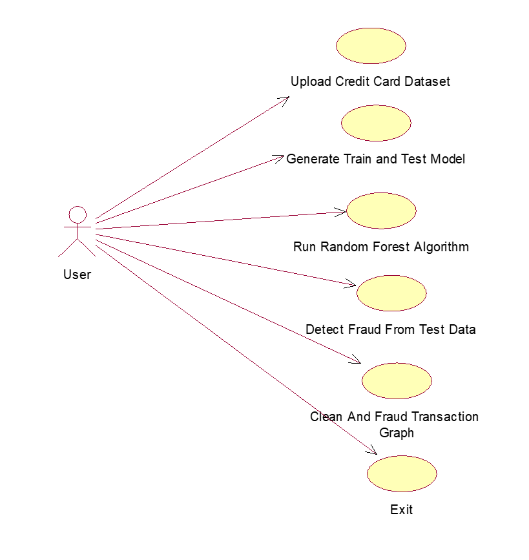
Design/Architecture

Slide 17
MODULES:-
Data Preprocessing – Cleaning, normalization, and feature selection.
Model Training – Random Forest with hyperparameter tuning and imbalance handling
Real-Time Prediction – Instant fraud detection on live transaction data
Alert System – Triggers and logs suspicious activity
Evaluation & Feedback – Continuous performance monitoring and model updates

Slide 18

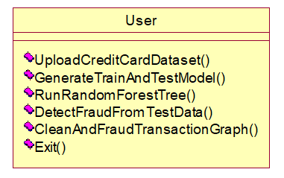
UML Diagrams:-
Usecase Diagrams
Class Diagram

Slide 19
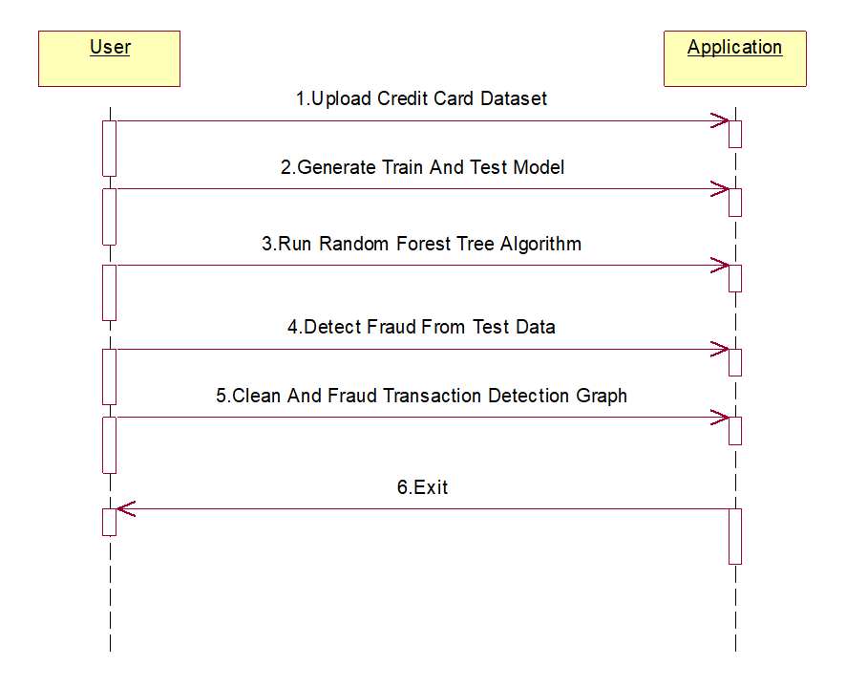
UML Diagrams
Sequence Diagram

Slide 20
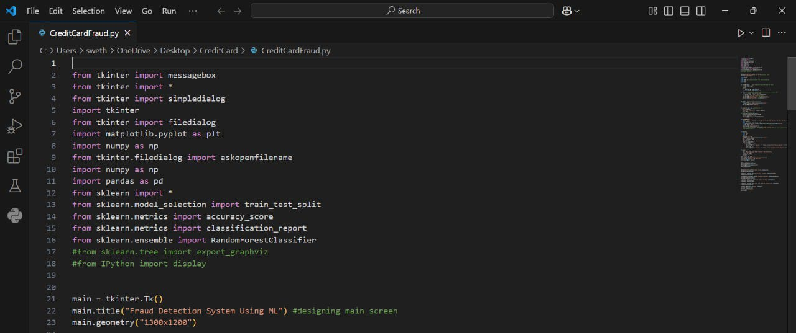
Sample Code:-

Slide 21
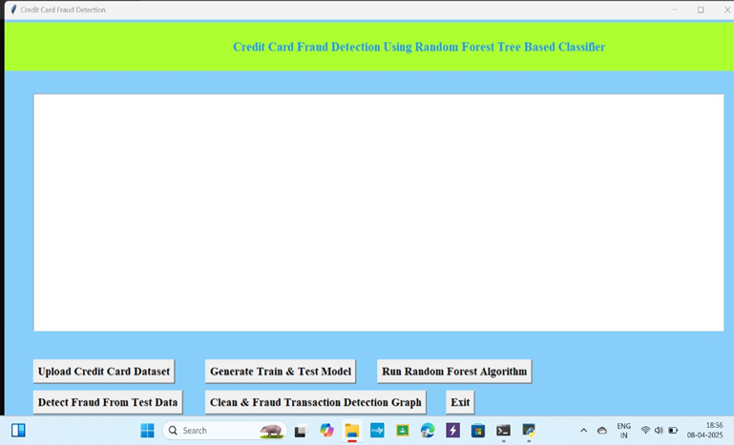
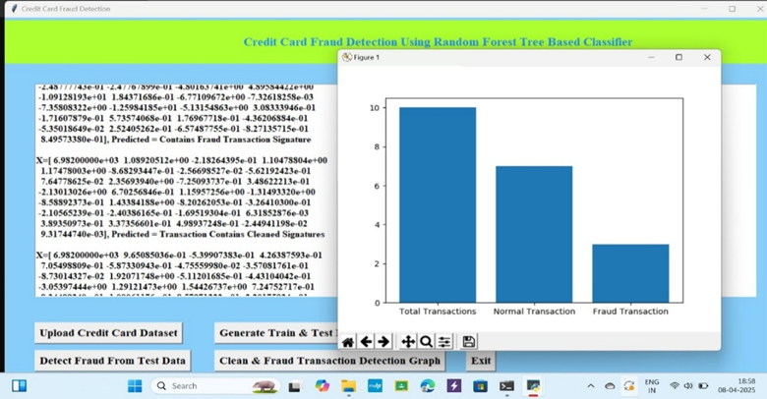
Result:-

Slide 22
Conclusion
The Random forest algorithm will perform better with a larger number of training data, but speed during testing and application will suffer. Application of more pre-processing techniques would also help. The SVM algorithm still suffers from the imbalanced dataset problem and requires more preprocessing to give better results at the results shown by SVM is great but it could have been better if more preprocessing have been done on the data.

Slide 23
Future Scope:-
Integration with Banking Systems: Deploy in real-time with live banking APIs for direct fraud prevention
Advanced Algorithms: Explore deep learning (e.g., LSTM, Autoencoders) for better accuracy
Adaptive Learning: Implement models that update automatically with new fraud patterns
Behavioral Biometrics: Include user behavior analytics for multi-factor fraud detection
Global Deployment: Extend the system to handle cross-border transactions and multiple currencies

Slide 24
References
[1] Sudhamathy G: Credit Risk Analysis and Prediction Modelling of Bank Loans Using R, vol. 8, no-5, pp. 1954-1966.
[2] LI Changjian, HU Peng: Credit Risk Assessment for ural Credit Cooperatives based on Improved Neural Network, International Conference on Smart Grid and Electrical Automation vol. 60, no. - 3, pp 227-230, 2017.
[3] Wei Sun, Chen-Guang Yang, Jian-Xun Qi: Credit Risk Assessment in Commercial Banks Based On Support Vector Machines, vol.6, pp 2430-2433, 2006.
[4] Amlan Kundu, Suvasini Panigrahi, Shamik Sural, Senior Member, IEEE, “BLAST-SSAHA Hybridization for Credit Card Fraud Detection”, vol. 6, no. 4 pp. 309-315, 2009.
[5] Y. Sahin and E. Duman, “Detecting Credit Card Fraud by Decision Trees and Support Vector Machines, Proceedings of International Multi Conference of Engineers and Computer Scientists, vol. I, 2011.

Slide 25


